Slide 1
NODE.JS
(The Backend Of MERN Stack)
Lecture 33

Slide 2
Today’s Agenda
Updating Data In MongoDB
Using updateOne()
Update operators
Using updateMany()
Exercises

Slide 3
Updating data in mongodb
To Update Data in MongoDB document, we can use 2 methods called updateOne and updateMany
Method | Description
db.collection.updateOne() | It is used to update a single document in the collection that satisfy the given criteria.
db.collection.updateMany() | It is used to update multiple documents in the collection that satisfy the given criteria.

Slide 4
Using updateOne()
We use the db.<collection>.updateOne() method to update a single document in a collection that matches with the specified filter criteria.
It updates the first matching document even if multiple documents match with the criteria.

Slide 5
Syntax of updateOne()
Syntax:
db.collection.updateOne(filter, document, options)
Parameters:
filter: The selection criteria for the update, same as find() method.
document: A document that contains modifications to apply through update operator.
options: Optional. May contain options for update behavior like upsert.

Slide 6
What are update operators ?
update operators are special operators which can be used with the updateOne() and updateMany() methods.
The four very commonly used operators are:
$set
$inc
$mul
$unset

Slide 7
The $set operator
The $set operator replaces the value of a field with the specified value.
Syntax:
{ $set: { <field1>: <value1>, ... } }
Special Note:
If the field does not exist, then the $set will add a new field with the specified value.

Slide 8
Syntax of updateOne() with $set
Following is the detailed syntax of updateOne() when used with $set.
Syntax:
db.collection.updateOne({filter},{ $set: { <field1>: <value1>, ... } })

Slide 9
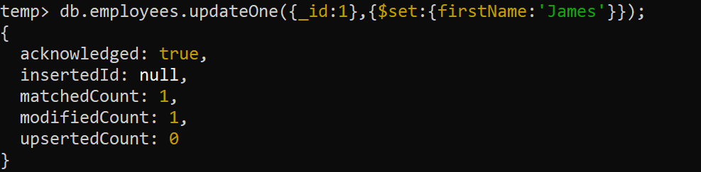
Example
Update the firstName to “James” of the employee whose _id is 1

Slide 10
Explanation of arguments to updateOne()
The first parameter is the filter criteria specified as a document, {_id:1} indicates that find a document whose _id is 1.
The second parameter is used to specify fields and values to be modified on the matching document .
The format will be {<update-operator>: { field: value, field:value,... }
The update operator decides what action to perform.

Slide 11
Explanation of arguments to updateOne()
Here we want to set the value of a field, so we used $set operator to specify fields and updated values in the format {field:updated-value}
The code { $set: {firstName:’James'}} modifies the firstName to “James" in the first document that matches with the specified criteria which is {_id:1}

Slide 12
Explanation of return value of updateOne()
In the output, the key matchedCount indicates the number of documents that matched with the criteria, and modifiedCount indicates the number of documents updated.

Slide 13
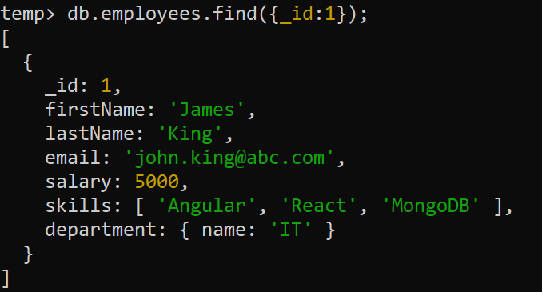
Verifying updateOne()

Slide 14
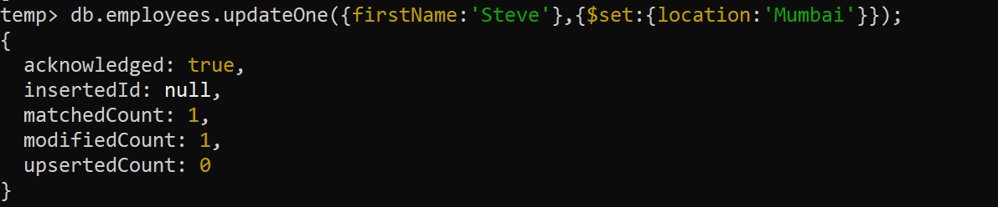
Adding new field
The $set operator adds the specified field if it does not exist in a matching document.
For example, the following code will add the location field.

Slide 15
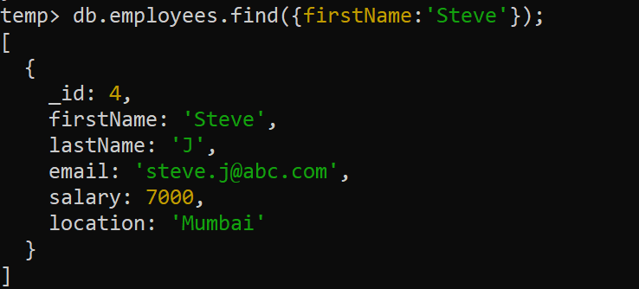
verifying

Slide 16
The $inc operator
We can use the $inc update operator to increase the value of the field by the specified amount.
Syntax:
{ $inc: { <field1>: <amount1>, ... } }
Special Note:
The $inc operator accepts both positive and negative values.
If the field does not exist, then $inc creates the field and sets the field to the specified value.

Slide 17
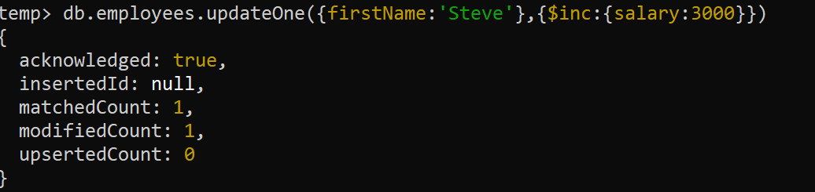
Example
Increment the salary by 3000 of the employee with firstName equal to “Steve”

Slide 18
The $mul operator
We can use the $mul update operator to multiply the value of the field by a given number.
Syntax:
{ $mul: { <field1>: <number1>, ... } }
Special Note:
The $mul operator accepts both positive and negative values.
If the field does not exist, then $mul creates the field and sets the value to zero of the same numeric type as the multiplier.

Slide 19
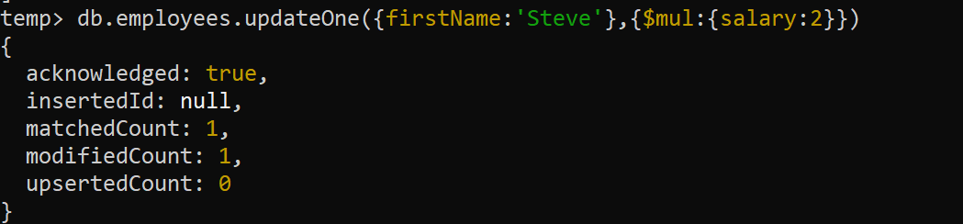
Example
Double the salary of the employee with firstName equal to “Steve”

Slide 20
Using $unset operator
We can use the $unset update operator to delete a field from the document.
Syntax:
{ $unset: { <field1>: “”, ... } }
Special Note:
If the field does not exist, then $unset does nothing.

Slide 21
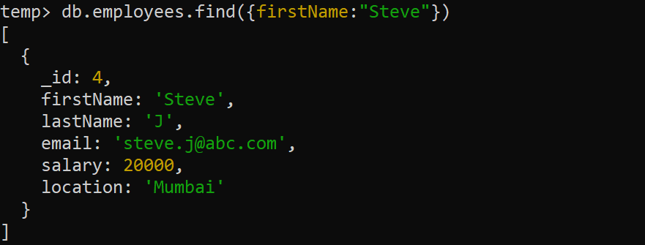
Example
Delete the field location from the employee with firstName equal to “Steve”.
Before deleting:

Slide 22
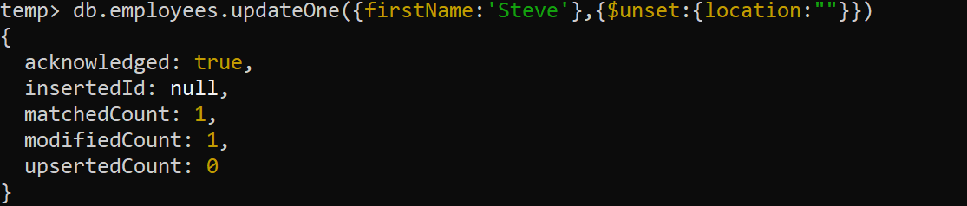
Example
Deleting the field location

Slide 23
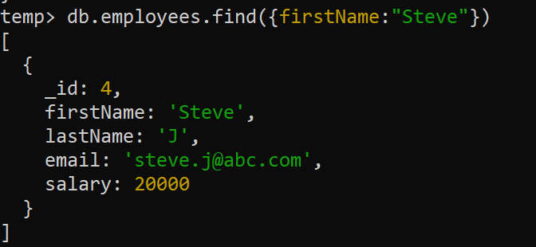
Example
After deletion:

Slide 24
Using updateMany()
We use the db.<collection>.updateMany() method to update a multiple document in a collection that match with the specified filter criteria.
Syntax:
db.collection.updateMany(filter, document, options)

Slide 25
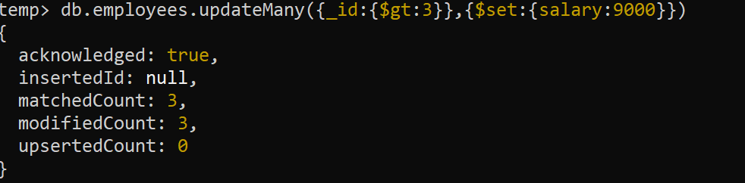
Example
Set the salary of all those employees to 9000 who have an _id > 3

Slide 26
upsert
We can specify {upsert:true} as a third parameter in the updateMany() method.
The upsert:true adds a new document if the matching document is not found.

Slide 27
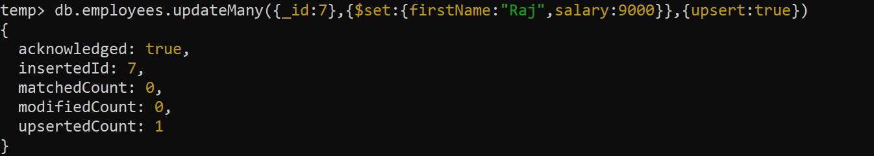
Example
Set the firstName to Raj and salary to 9000 for the employee with _id equal to 7.
If no record of _id 7 is found then insert a new record

